Slide 1
BT201
Biochemical Process Calculations
16/11/2022

Slide 2
Energy balance with reaction
In any reaction between stable molecules, energy is required to break the reactant chemical bonds and energy is released when the product bonds form.
If the first process absorbs less energy than the second process releases the reaction is exothermic: the product molecules at a given temperature and pressure have lower internal energies (and hence lower enthalpies) than the reactant molecules at the same temperature and pressure.
The net energy released—the heat of reaction —must be transferred from the reactor as heat or work, or else the system temperature increases.
On the other hand, if less energy is released when the product bonds form than it took to break the reactant bonds, the reaction is endothermic: energy must be added to the reactor as heat or work to keep the temperature from decreasing.

Slide 3
The large internal energy and enthalpy changes commonly associated with chemical reactions can play major roles in the design and operation of chemical/biochemical processes.
If a reaction is endothermic, the energy needed to keep the reactor temperature (and hence the reaction rate) from dropping too much may cost enough to turn a profitable process into an unprofitable one.
On the other hand, if the reaction is exothermic, heat usually must be transferred away from the reactor to keep the temperature below a value that leads to safety or product quality problems.
An energy balance on a reactor tells the process engineer how much heating or cooling the reactor requires in order to operate at the desired conditions

Slide 4


Heat of reaction
Consider the reaction between solid calcium carbide and liquid water to form solid calcium hydroxide and gaseous acetylene
It signify that if 1 mol of solid calcium carbide reacts completely with 2 mol of liquid water to form 1 mol of solid calcium hydroxide and 1 mol of gaseous acetylene, and the initial and final temperatures are both 25 °C and the initial and final pressures are both 1 atm, then H_{products} - H_{reactants}=-125.4 kJ.
If the reaction is run under conditions such that the energy balance reduces to , Q=ΔH then 125.4 kJ of heat must be transferred from the reactor in the course of the reaction. (Recall that a negative implies flow of heat out of the system.)

Slide 5
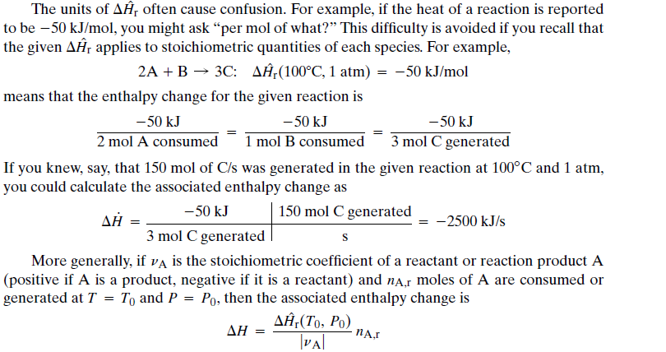


Extent of reaction

Slide 6
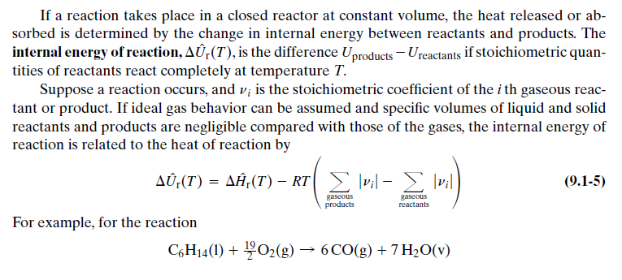
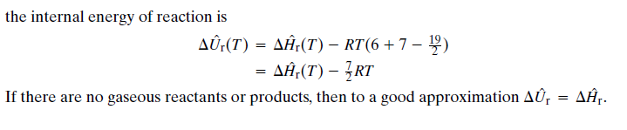
Closed reactor at constant volume

Slide 7
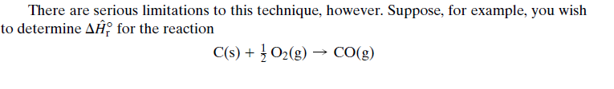
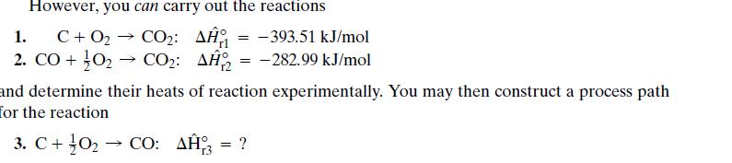
CALCULATION OF HEATS OF REACTION: HESS’S LAW
You could put 1 mole of carbon and 0.5 mole of oxygen together in a reactor, but you would never get 1 mole of carbon monoxide as the final product. If the reactants are at or near 25 °C or lower, nothing apparent would occur since the rate at which carbon and oxygen react at this temperature is immeasurably low.
If, on the other hand, the mixture were heated to a temperature at which C and O2 react at a measurable rate, the product would be either pure CO2 or at best a mixture of CO and CO2 , making it impossible to determine the heat of the CO formation reaction alone.

Slide 8
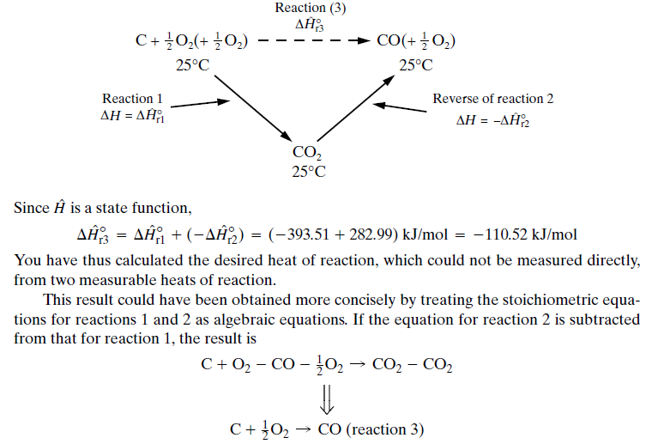


Slide 9
